Slide 1
University of Lucknow
( FoET )
Mini Project Presentation
B.Tech CSE - 3rd Year , Sem - 6
2024-25
Team Members
Sneha Singh
Sonakshi Yadav
Varalika Dwivedi
( 22XXXXXXXX111 )
( 22XXXXXXXX113 )
( 22XXXXXXXX124 )
Team Leader
Team Member
Team Member

Slide 2

Project Title : Heart Disease Prediction Model
Problem Statement
Solution
This project aims to predict heart disease using the UCI dataset based on clinical features like age, blood pressure, cholesterol, and chest pain. The goal is to build a machine learning model to support early diagnosis by detecting patterns linked to heart disease.
The solution involves implementing and comparing three supervised learning models: Logistic Regression, Decision Tree, and Random Forest. These models are trained on the dataset and evaluated using accuracy, precision, recall, and F1 score

Slide 3
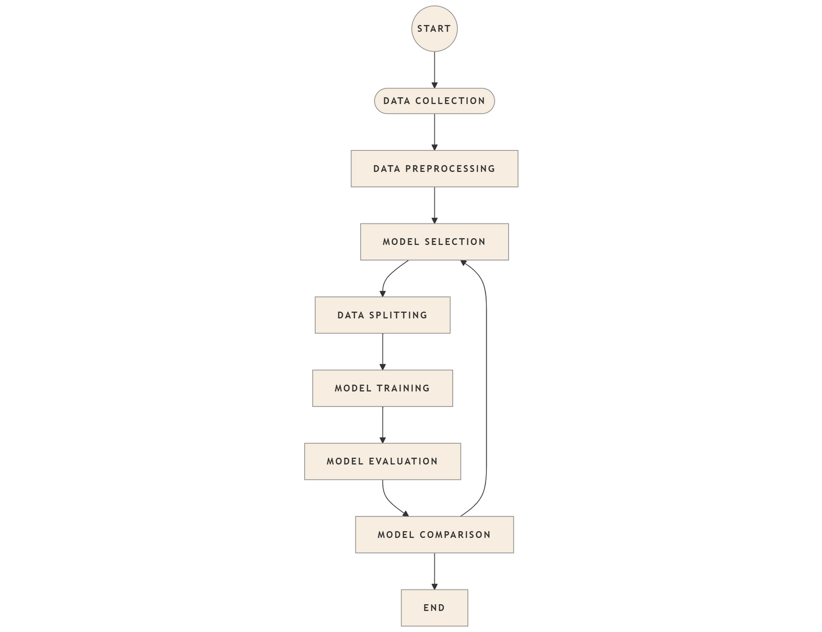
Work Flow
Flow Chart
Data Collection
↓
Data Preprocessing
→ Handle missing values
→ Encode categorical features
↓
Train-Test Split (e.g., 70/30)
↓
Model Selection
→ Logistic Regression
→ Decision Tree
→ Random Forest
↓
Model Training on training set
↓
Model Evaluation on test set
→ Metrics: Accuracy, Precision, Recall, F1-score
↓
Model Comparison
→ Weighted metric-based ranking (recall emphasized)
↓
Best Model Selection

Slide 4
Impact and Benefits
Feasibility
Scalability: Can be deployed in digital health platforms or Integrated into electronic health record (EHR) systems for broader reach.
Data Availability: The UCI Heart Disease dataset is publicly accessible and well-structured.
Technical Implementation: Models like Logistic Regression, Decision Tree, and Random Forest are well-supported by libraries like scikit-learn.
Model Transparency: Use of interpretable models (e.g., logistic regression) allows for trust and explanation in medical contexts.
Challenges
Viability
Feature Correlation: Some features may be correlated or redundant, requiring careful preprocessing.
High for Research & Prototyping: Excellent as a proof-of-concept for academic, educational, or initial clinical research.
Extendable: Future work can include ensemble techniques for better performance.
Overfitting: Especially in tree-based models, if not properly tuned (e.g., depth, min samples).

